Slide 1
HIV 50+ STRONG &
HEALTHY POLICY & ADVOCACY
A TRAINING BY
Cecilia Chung and Bridgette Picou

Slide 2
INTRODUCTIONS
Your name
Your gender pronouns (he, them, ze, etc)
When you were diagnosed
Involvement in HIV services
One word that describes your experience with aging!

Slide 3
COMMUNITY PROMISES
01.
02.
03.
Be respectful of other viewpoints and experiences
Be open to learning
Vegas Rule: what happens here, stays here

Slide 4
ZOOM LOGISTICS
Turn your camera on
Don’t put call on hold
Mute your phone unless speaking
Use hand signals
Use the chat room

Slide 5
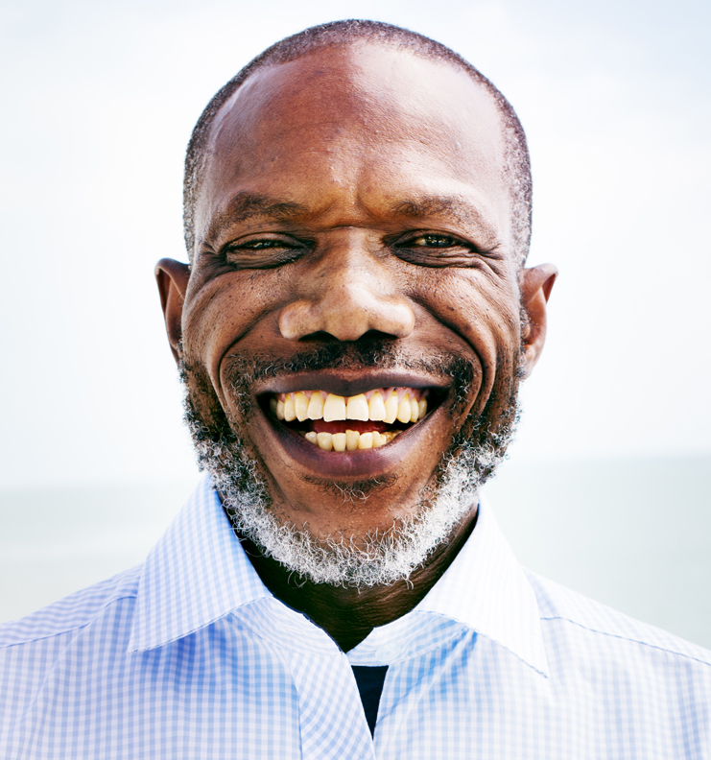
OUR AGENDA
Defining Advocacy
Our History
Examples of Activism
Meeting our Needs
Taking Action at the National Level
Our Next Steps…

Slide 6
MODULE 1:
DEFINING ADVOCACY

Slide 7
WHAT IS ADVOCACY?
KEY ELEMENTS OF ADVOCACY
ADVOCACY METHODS
SPEAKING FOR YOURSELF AND OTHERS
Drawing attention to an issue
Presenting solutions
Engaging in activities to educate the public and build support
Meetings with policymakers
Using social media
Engaging mainstream media
Anything here for balance with other columns?

Slide 8
OUR EXPERIENCES
What is it like to age with HIV?

Slide 9
10 Good Things About Getting Older:
I've become less emotional and more thoughtful with my decisions.
I no longer sweat the small stuff.
I can go shopping for what I need in my favorite store: my basement.
I’ve become kinder to myself.
Liking myself.
AGING WITH HIV: THE GOOD AND THE BAD
PORTFOLIO HERE.

Slide 10
10 Good Things About Getting Older (continued):
I no longer drool over — or covet — fashion must-haves.
I have so many good stories to tell.
All my years of living make me sound smart.
I no longer need to keep up with the Joneses.
It's safe (and fun) to flirt.
AGING WITH HIV: THE GOOD AND THE BAD

Slide 11
10 Worst Things About Aging That You Wish Grandparents Warned You About:
Dull and thinning hair
The turkey neck
Spend more time in hospitals
The knees and joints hurt
Sore feet
AGING WITH HIV: THE GOOD AND THE BAD
PORTFOLIO HERE.

Slide 12
10 Worst Things About Aging That You Wish Grandparents Warned You About (continued):
Hard lines and wrinkles
The body slows down
Cognitive decline
Plan early for retirement
Have fun and remember to smell the flowers
Citations
https://www.sciencecare.com/blog/10-worst-things-about-aging-that-you-wish-grandparents-warned-you-about
AGING WITH HIV: THE GOOD AND THE BAD

Slide 13
MODULE 2:
OUR HISTORY

Slide 14
EARLY ACTIVISM:
THE DENVER PRINCIPLES

Slide 15
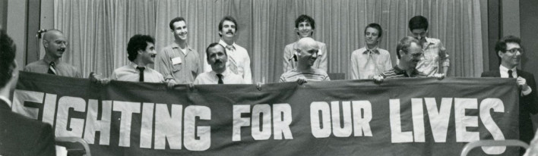
DENVER
PRINCIPLES
We condemn attempts to label us as "victims," a term which implies defeat, and we are only occasionally "patients," a term which implies passivity, helplessness, and dependence upon the care of others. We are "People With AIDS.”
Recommendations for All People
Support us in our struggle against those who would fire us from our jobs, evict us from our homes, refuse to touch us or separate us from our loved ones, our community or our peers, since available evidence does not support the view that AIDS can be spread by casual, social contact.
Not scapegoat people with AIDS, blame us for the epidemic or generalize about our lifestyles.

Slide 16
DENVER
PRINCIPLES
Recommendations for People with AIDS
Form caucuses to choose their own representatives, to deal with the media, to choose their own agenda and to plan their own strategies.
Be involved at every level of decision-making and specifically serve on the boards of directors of provider organizations.
Be included in all AIDS forums with equal credibility as other participants, to share their own experiences and knowledge.
Substitute low-risk sexual behaviors for those which could endanger themselves or their partners; we feel people with AIDS have an ethical responsibility to inform their potential sexual partners of their health status.

Slide 17
DENVER
PRINCIPLES
Rights of People with AIDS
To as full and satisfying sexual and emotional lives as anyone else.
To quality medical treatment and quality social service provision without discrimination of any form including sexual orientation, gender, diagnosis, economic status or race.
To full explanations of all medical procedures and risks, to choose or refuse their treatment modalities, to refuse to participate in research without jeopardizing their treatment and to make informed decisions about their lives.
To privacy, to confidentiality of medical records, to human respect and to choose who their significant others are.
To die -- and to LIVE -- in dignity.

Slide 18
WE ARE THE
EXPERTS.
MIPA: Meaningful Involvement of People with AIDS/HIV

Slide 19
AIDS ACTIVISM:
MAKING OURSELVES SEEN & HEARD

Slide 20
MODULE 3:
EXAMPLES OF ACTIVISM

Slide 21
MODULE 3: EXAMPLES OF ACTIVISM
ACT UP
The AIDS Coalition to Unleash Power—better known as ACT UP—is one of the first examples of people taking their activism and anger about a disease to the streets. ACT UP was formed in New York City in 1987. Throughout the 80s, ACT UP's primary focus was on access to experimental AIDS drugs and a coordinated national policy to fight the disease.

Slide 22
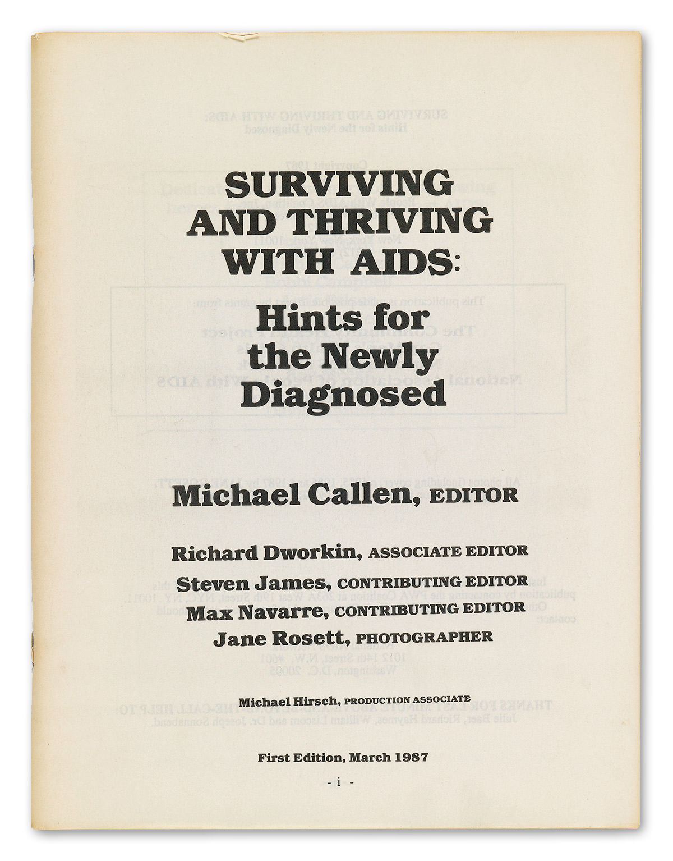
MODULE 3: EXAMPLES OF ACTIVISM
PEOPLE WITH AIDS COALITIONS
The People with AIDS Coalition in New York City was formed in 1985. Their motto was "Fighting for Our Lives." The coalition published Surviving and Thriving with AIDS, a manual that provided practical information on how to live with HIV—the voice of experience.

Slide 23
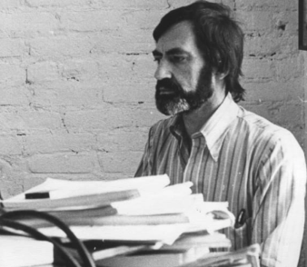
MODULE 3: EXAMPLES OF ACTIVISM
BUYERS’ CLUBS
The PWA (People With AIDS) Health Group was founded in 1987 in New York City, and it was dedicated to providing access to promising or experimental treatments for HIV/AIDs. The PWA Health Group was founded by Thomas Hannan and Michael Callen, both PWAs, and their physician, Joseph Sonnabend MD, and it was organized in New York State as People With AIDS Working for Health, Inc.
Joseph Sonnabend MD
Michael Callen

Slide 24
LEGACY OF ACTIVISM:
DID IT MAKE A DIFFERENCE?

Slide 25
ACTIVISM TODAY:
ELDERS WITH HIV ARE USING THEIR VOICES

Slide 26
ELDERS WITH HIV ARE
USING THEIR VOICES
SAGE is an advocacy and resource organization focused on LGBTQ elders. It focuses on the needs of long-term HIV survivors and LGBTQ older people living with HIV, advocating for policies and services that are responsive to their needs.
Let's Kick ASS (AIDS Survivor Syndrome) is a volunteer, grassroots movement to empower long-term survivors and elder people with HIV
The Reunion Project, a project of the Test Positive Aware Network or TPAN, is the national alliance of long-term survivors of HIV. It holds national and local educational and advocacy events.

Slide 27
NMAC’S BLOC PROGRAM
TRAINING PEOPLE OF COLOR WITH HIV TO BE LEADERS

Slide 28
NMAC’S
BLOC PROGRAM
It is designed to train people of color living with HIV in leadership roles to improve HIV service delivery. BLOC also promotes racial justice and health equity.
BLOC is a “train the trainer” program. Participants commit to conducting BLOC trainings for people of color with HIV in their community.

Slide 29
NMAC’S
50+ STRONG & HEALTHY
NMAC's HIV 50+ Strong and Healthy program offers participants the opportunity to give back to their community by giving them the tools to self-advocate and advocate for their peers.
NMAC‘s Treatment Division helps trainees organize educational opportunities and community events for their peers and advocacy activities focused on Congress, federal agencies, and the administration. For more information on the program, visit: https://www.nmac.org/Treatment

Slide 30
MODULE 4:
MEETING OUR NEEDS

Slide 31
IDENTIFYING NEEDS:
LISTEN TO THE COMMUNITY

Slide 32
LISTEN TO
THE COMMUNITY
This can be done through various methods:
Town hall meetings, either in person or online
Focus groups—small groups, less than 15 people, that are asked to respond to specific questions
Key informant interviews—interviews with either clinicians or people with HIV, such as peer navigators, who have direct knowledge of service needs
Consumer surveys, either written or online

Slide 33
WHAT WE KNOW:
COMMON NEEDS OF OLDER PEOPLE WITH HIV

Slide 34
NEEDS OF ELDER
PEOPLE WITH HIV
Given the diversity of elder people with HIV, needs will vary significantly. However, there are common needs that should be addressed.
Better coordination of HIV and geriatric care
Mental health support
Food instability
Housing instability
Social support, such as peer support and social opportunities

Slide 35
SOCIAL SUPPORT:
IMPORTANT TO YOUR PHYSICAL AND MENTAL HEALTH

Slide 36
SOCIAL SUPPORT
Isolation and loneliness are a major issue for elder people with HIV. Loneliness can impact both physical and mental health. Providing more opportunities for people aging with HIV to socialize is important.
Many organizations provide organized social activities and buddy programs. There are many options.
These can be HIV-specific or open to all aging people.

Slide 37
MODULE 5:
TAKING ACTION AT THE NATIONAL LEVEL

Slide 38
RYAN WHITE HIV/AIDS PROGRAM:
CARE FOR LOW-INCOME PEOPLE WITH HIV

Slide 39
RYAN WHITE PROGRAM:
YOU HAVE A VOICE
A key aspect of the Ryan White Program is that organizations receiving funds must get input from clients.
States and Part A recipients, that is, hard-hit cities, engage in local planning activities that must include people with HIV.
Clinics that receive Ryan White funding are encouraged to include people with HIV in their decision-making, such as serving on a consumer advisory board, and in quality improvement activities.
Ryan White-funding providers must also carry out activities to assess consumer satisfaction such as surveys or focus groups.

Slide 40
OLDER AMERICANS ACT:
PROVIDING SOCIAL AND NUTRITION SERVICES

Slide 41
OLDER AMERICANS ACT
There is federal legislation to address the needs of older Americans.
The Older Americans Act supports the delivery of social and nutrition services to older Americans and their caregivers. It includes:
Community service employment for low-income older Americans
Training, research, and demonstration activities addressing aging
Activities to protect the rights of the elderly, such as preventing elder abuse
Citations:
Administration for Community Living. Older Americans Act. Retrieved from: https://acl.gov/about-acl/authorizing-statutes/older-americans-act

Slide 42
LOCAL AREA AGENCIES ON AGING:
TAILORING SERVICES TO THE COMMUNITY

Slide 43
LOCAL AREA
AGENCIES ON AGING
An Area Agency on Aging, also known as an AAA, is a public or nonprofit agency designated by a state to address the needs of older people.
States can have multiple AAA's, which are usually responsible for a city, county, or multi-county area.
AAAs coordinate and provide services that help older people remain in their homes and live independently, like providing home-delivered meals and housekeeping assistance.
Some AAAs are developing services tailored for the LGBTQ community.
Citations:
Administration for Community Living. Area Agencies on Aging. Retrieved from: https://acl.gov/programs/aging-and-disability-networks/area-agencies-aging

Slide 44
SAMHSA:
SUBSTANCE ABUSE AND MENTAL HEALTH SERVICES AGENCY

Slide 45
SAMHSA: SUBSTANCE ABUSE AND
MENTAL HEALTH SERVICES AGENCY
SAMHSA is a federal agency, part of the Department of Health and Human Services, focused on reducing the impact of substance use disorder and mental illness.
SAMHSA provides resources for patients and can also help connect them to service providers.
SAMHSA also provides training and technical assistance to providers.

Slide 46
HOUSING OPPORTUNITIES FOR PERSONS WITH AIDS AND MORE:
PROVIDING STABLE AND SAFE HOUSING TO THOSE IN NEED

Slide 47
HOPWA: HOUSING OPPORTUNITIES
FOR PERSONS WITH AIDS
The Housing Opportunities for Persons with AIDS (HOPWA) Program makes grants to local communities, states, and nonprofit organizations to provide housing services for low-income people with HIV and their families.
There are also many housing resources for elder individuals, including people with HIV, but the age criteria for these programs is higher, often 65 years of age.

Slide 48
MODULE 6: OUR NEXT STEPS
COMMUNITY ENGAGEMENT & MOBILIZATION

Slide 49
NMAC’S NATIONAL HIV & AGING
ADVOCACY NETWORK
This is a network of individuals advocating for people aging with HIV.
The network shares information with members and works with local and national organizations and policy groups to address issues related to HIV and aging.

Slide 50
NMAC’S NATIONAL HIV & AGING
ADVOCACY NETWORK PRIORITIES
Help people aging with HIV maximize their physical, social, and financial independence and quality of life.
Advocate for policies, programs and services that address HIV Long-Term Survivor trauma and other physical and mental health conditions resulting from trauma.
Advocate for economic and social justice issues affecting persons aging with HIV
Support modernization of the Ryan White HIV/AIDS Program

Slide 51
SAGE’S HIV & AGING POLICY
ACTION COALITION
The coalition is focused on building a diverse group of long-term HIV survivors and LGBTQ elder people living with HIV.
It supports advocacy effort to ensure that policymakers understand the intersection between aging and HIV – especially its impact on marginalized communities, such as LGBTQ people of color with HIV.
The coalition is active at the national and state level to bring about change.

Slide 52
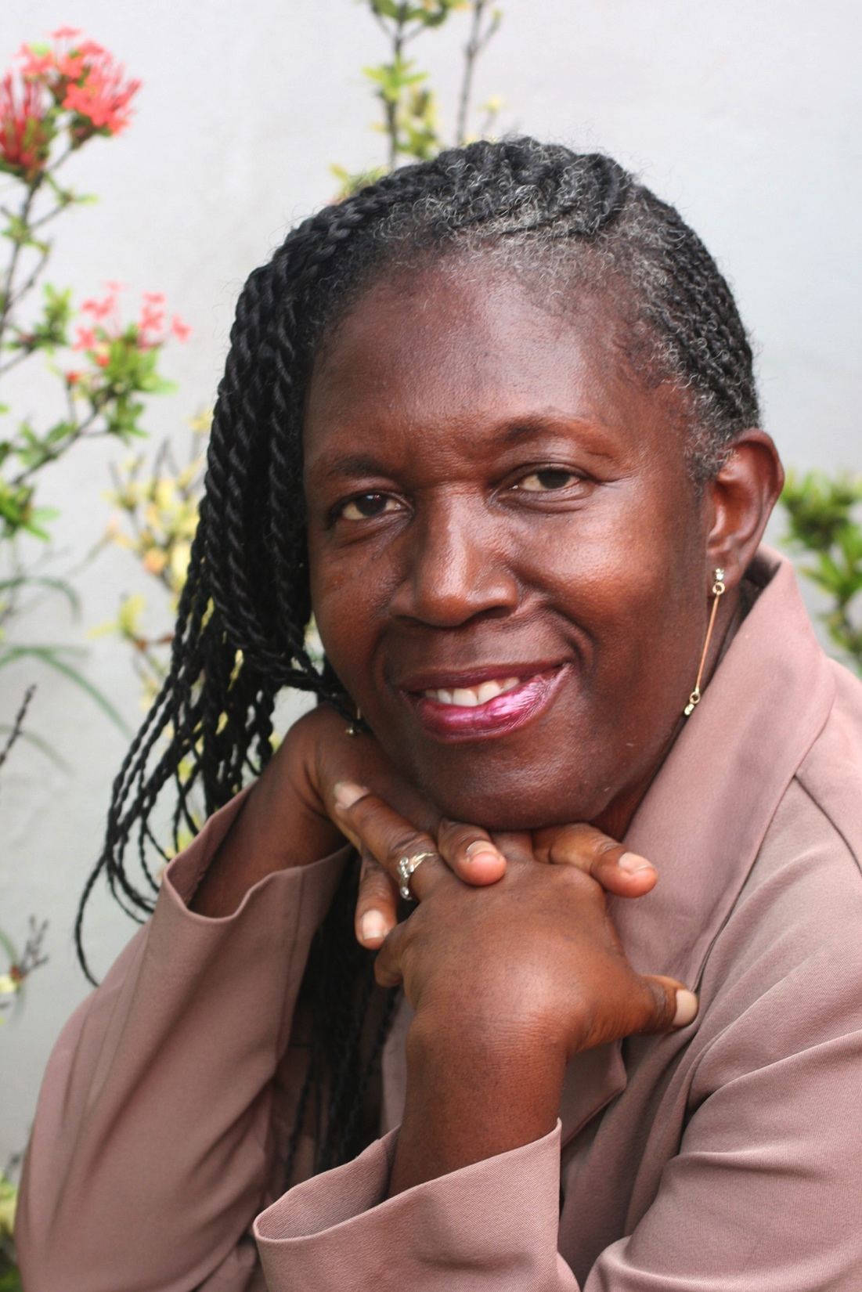
SAGE’S HIV & AGING POLICY
ACTION COALITION PRIORITIES
Passage of Long-Term Survivor Bill of Rights (at state level)
Create model cultural competency training for providers with input from long-term survivors, policymakers, and ally organizations
Gain greater understanding of health issues confronting elder people with HIV
Address financial, employment, and housing issues confronting elder people with HIV.

Slide 53
AIDSWatch: TAKING OUR VOICES
TO CAPITOL HILL
For almost 30 years, HIV advocates have been participating in AIDSWatch, which is coordinated by AIDS United, the US PLHIV Caucus and the Treatment Access Expansion Project.
The event, held in March, brings advocates to Washington, DC for training on important issues and how to advocate. After the training, advocates meet with members of Congress.

Slide 54
SOCIAL MEDIA AS AN ADVOCACY TOOL:
STAY INFORMED & RAISE YOUR VOICE
Social media has become an important advocacy tool.
You can stay informed of latest developments by following organizations and individuals.
Like, comment on, and share their posts to help spread the word.
Make your own posts—you too can become an influencer.

Slide 55
DISCUSSION:
WHAT HAVE WE LEARNED? WHAT WILL WE DO?

Slide 56
PROMPTS
Do you think more advocacy is necessary? What are the major issues related to HIV in general? What are your major issues as you age?
Can you think of ways to get involved in your community? Like with the Ryan White planning groups?

Slide 57
WRAP UP

Slide 58
Facilitator: email address
NMAC magosto@nmac.org
THANK YOU!

